Slide 1




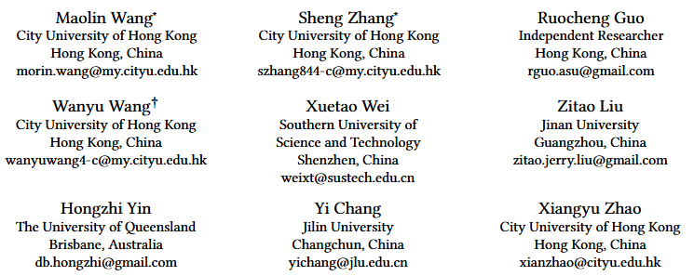





ATAI
Advanced Technique of Artificial Intelligence
ATAI
ChongqingUniversity _{AdvancedTechniqueof}
of Technology Artificial Intelligence
Chongqing University of
Technology
Chongqing University ^{ATAI}
_{of Technology} Advanced Techniqueof
Artificial Intelligence
Chongqing University of Technology
Chongqing University of Technology
STAR-Rec :Making Peace with Length Variance and Pattern Diversity in Sequential Recommendation
Code : https://github.com/Applied-Machine-Learning-Lab/Star-Rec
——SIGIR_2025
Reported by Yuhang Jang
1

Slide 2
ATAI
Advanced Technique of Artificial Intelligence
ATAI
ChongqingUniversity _{AdvancedTechniqueof}
of Technology Artificial Intelligence
Chongqing University of
Technology
Chongqing University ^{ATAI}
_{of Technology} Advanced Techniqueof
Artificial Intelligence
Chongqing University of Technology
Chongqing University of Technology
Motivation
1)Recent deep sequential recommendation models often struggle to effectively model key characteristics of user behaviors, particularly in handling sequence length variations and capturing diverse interaction patterns.
2)Sequential recommender systems need to address three fundamental challenges: (1) Items Pattern Diversity; (2) Length Variance; (3) Behavioral Pattern Diversity

Slide 3
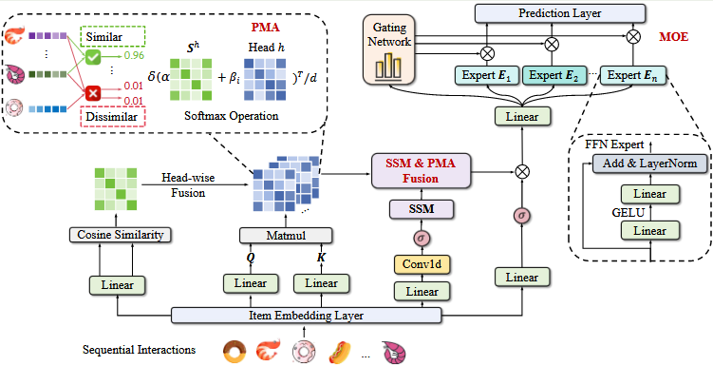
ATAI
Advanced Technique of Artificial Intelligence
ATAI
ChongqingUniversity _{AdvancedTechniqueof}
of Technology Artificial Intelligence
Chongqing University of
Technology
Chongqing University ^{ATAI}
_{of Technology} Advanced Techniqueof
Artificial Intelligence
Chongqing University of Technology
Chongqing University of Technology
Method
Notes:
对于最右边的操作，在代码与论文中并没有纤细的说明，因此会认为是错的！

Slide 4

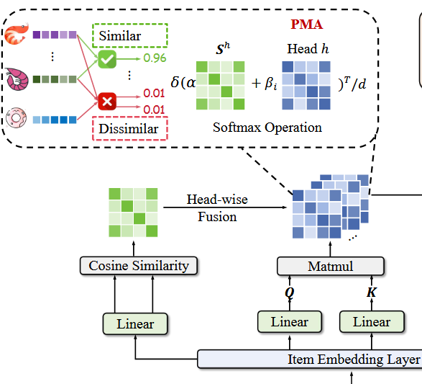





ATAI
Advanced Technique of Artificial Intelligence
ATAI
ChongqingUniversity _{AdvancedTechniqueof}
of Technology Artificial Intelligence
Chongqing University of
Technology
Chongqing University ^{ATAI}
_{of Technology} Advanced Techniqueof
Artificial Intelligence
Chongqing University of Technology
Chongqing University of Technology
Method
Notes:
Embedding是经过映射（相当于乘以一个矩阵），主要作用可以进行缩小维度。通过不断地训练，会讲相似的物品映射到距离更近的向量空间

Slide 5



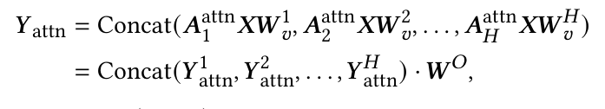
ATAI
Advanced Technique of Artificial Intelligence
ATAI
ChongqingUniversity _{AdvancedTechniqueof}
of Technology Artificial Intelligence
Chongqing University of
Technology
Chongqing University ^{ATAI}
_{of Technology} Advanced Techniqueof
Artificial Intelligence
Chongqing University of Technology
Chongqing University of Technology
Method

Slide 6
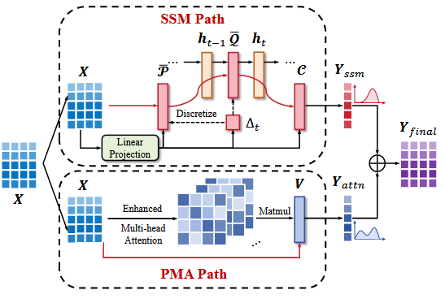

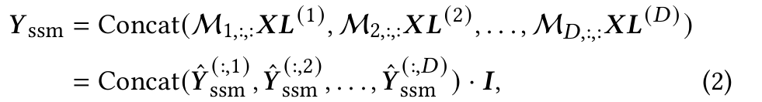
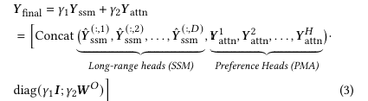
ATAI
Advanced Technique of Artificial Intelligence
ATAI
ChongqingUniversity _{AdvancedTechniqueof}
of Technology Artificial Intelligence
Chongqing University of
Technology
Chongqing University ^{ATAI}
_{of Technology} Advanced Techniqueof
Artificial Intelligence
Chongqing University of Technology
Chongqing University of Technology
Method

Slide 7
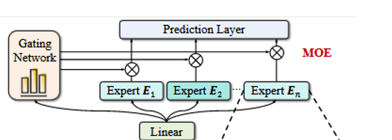

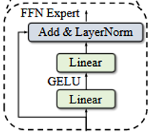
ATAI
Advanced Technique of Artificial Intelligence
ATAI
ChongqingUniversity _{AdvancedTechniqueof}
of Technology Artificial Intelligence
Chongqing University of
Technology
Chongqing University ^{ATAI}
_{of Technology} Advanced Techniqueof
Artificial Intelligence
Chongqing University of Technology
Chongqing University of Technology
Method

Slide 8


ATAI
Advanced Technique of Artificial Intelligence
ATAI
ChongqingUniversity _{AdvancedTechniqueof}
of Technology Artificial Intelligence
Chongqing University of
Technology
Chongqing University ^{ATAI}
_{of Technology} Advanced Techniqueof
Artificial Intelligence
Chongqing University of Technology
Chongqing University of Technology
Method

Slide 9

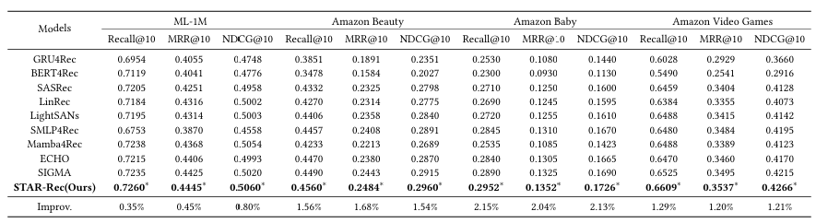
ATAI
Advanced Technique of Artificial Intelligence
ATAI
ChongqingUniversity _{AdvancedTechniqueof}
of Technology Artificial Intelligence
Chongqing University of
Technology
Chongqing University ^{ATAI}
_{of Technology} Advanced Techniqueof
Artificial Intelligence
Chongqing University of Technology
Chongqing University of Technology

Slide 10
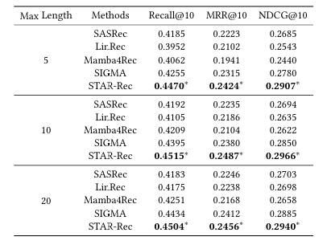
ATAI
Advanced Technique of Artificial Intelligence
ATAI
ChongqingUniversity _{AdvancedTechniqueof}
of Technology Artificial Intelligence
Chongqing University of
Technology
Chongqing University ^{ATAI}
_{of Technology} Advanced Techniqueof
Artificial Intelligence
Chongqing University of Technology
Chongqing University of Technology

Slide 11
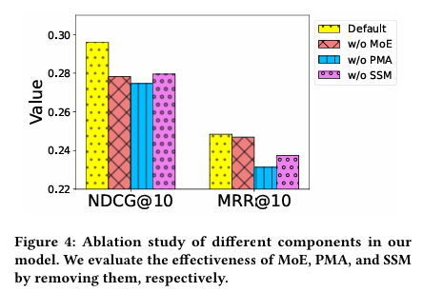
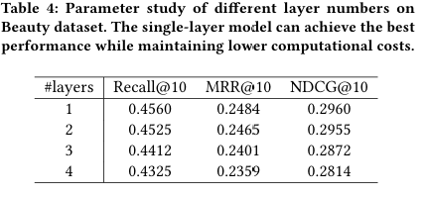
ATAI
Advanced Technique of Artificial Intelligence
ATAI
ChongqingUniversity _{AdvancedTechniqueof}
of Technology Artificial Intelligence
Chongqing University of
Technology
Chongqing University ^{ATAI}
_{of Technology} Advanced Techniqueof
Artificial Intelligence
Chongqing University of Technology
Chongqing University of Technology

Slide 12
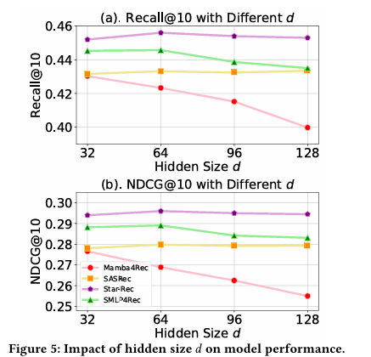
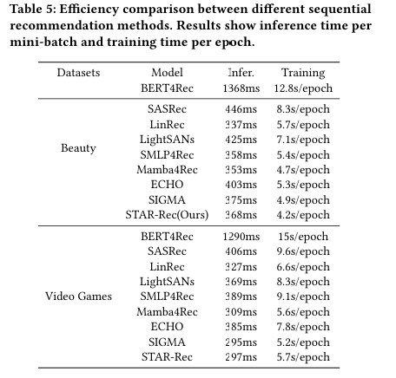
ATAI
Advanced Technique of Artificial Intelligence
ATAI
ChongqingUniversity _{AdvancedTechniqueof}
of Technology Artificial Intelligence
Chongqing University of
Technology
Chongqing University ^{ATAI}
_{of Technology} Advanced Techniqueof
Artificial Intelligence
Chongqing University of Technology
Chongqing University of Technology

Slide 13


ATAI
Advanced Technique of Artificial Intelligence
ATAI
ChongqingUniversity _{AdvancedTechniqueof}
of Technology Artificial Intelligence
Chongqing University of
Technology
Chongqing University ^{ATAI}
_{of Technology} Advanced Techniqueof
Artificial Intelligence
Chongqing University of Technology
Chongqing University of Technology
Thanks!

